Slide 1

SALES PERFORMANCE ANALYSIS
TEAM - 4

Slide 2

TEAM MEMBERS:
Prateek Maithil​
Golla Venkata Karthik Naidu Anubhav Sinha​
Rohit Nagulamalyala​

Slide 3
INTRODUCTION
Business Intelligence (BI) is a powerful solution that helps companies make intelligent decisions by transforming raw data into actionable insights. This project focuses on leveraging BI to monitor sales performance, enabling timely responses to external business environments. By organizing data into interactive dashboards, users can visualize current sales performance and gain clarity for informed decision-making. The outcomes aim to streamline information delivery and provide a roadmap for continuous improvement.

Slide 4
ABSTRACT
This project focuses on utilizing Business Intelligence (BI) tools to analyze and optimize sales performance. Through the development of dynamic dashboards and advanced visualizations, the project enables stakeholders to monitor key sales metrics, such as total sales, profit margins, and customer satisfaction, in real-time.
The analysis helps identify high-performing segments, sales channels, and regions, offering valuable insights for strategic decision-making. Ultimately, this project demonstrates how BI solutions can enhance business responsiveness, improve sales strategies, and support data-driven decision-making processes.

Slide 5
Problem Statement
Business Intelligence (BI) provides solutions that facilitate informed decision-making in business processes. With a suitable BI solution, companies can play an active role in timely monitoring business performance and swiftly responding to external business environments.
Outcomes:
The process of information delivery becomes smoother between visualized data and users than before. By viewing sales dashboard, users can clarify sales performance in current month.
Objectives:
Evaluate sales performance across different metrics
Identify trends and patterns
Improve profitability and customer retention

Slide 6
Methodology
Tools used: Business Intelligence(power BI)
Techniques applied:
Data cleaning and preparation
Analysis methods (e.g., trend analysis, segmentation, correlation analysis)
Visualization techniques (e.g., bar charts, heat maps, scatter plots)

Slide 7
Dataset Description
This dataset showcases the sales of a venture in the European region in different categories.
The dataset comprises the following columns that provide a comprehensive view of the sales process and customer interactions:
Basic Details: Invoice Number, Shipping Type, Order Date, Delivery Date, Payment Method.
Client Information: Client Code, Client Name, Client Segment, Location, Country, Region, Zip Code.
Product Information: Product Code, Product Category, Product Description, Warranty.
Sales Metrics: Sale Amount, Quantity, Discount Rate, Profit Margin, Unit Price. Customer Feedback: Customer Rating, Product Return Status, Customer Loyalty Program.
Marketing: Sales Channel, Marketing Campaign Code.

Slide 8
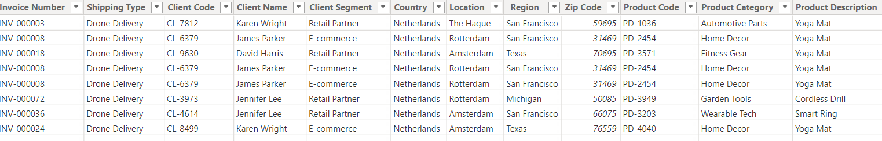
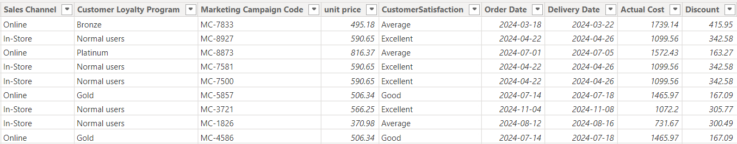
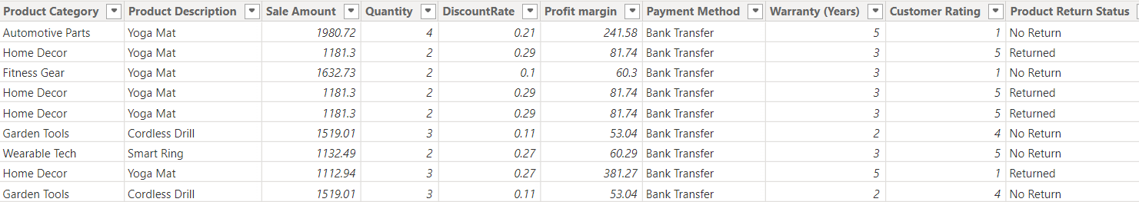
Dataset

Slide 9
Data Transformation and Calculated Columns
Changed data type of order to date complexity.
Sorted rows according to order date for better understanding.
Removed irrelevant rows from the dataset.
Used first row as headers.
Removed irrelevant columns from the dataset.
To derive insights from the dataset, several calculated columns were created using DAX in Power BI:
Actual Cost = [Sale Amount] - [Profit Margin]
Customer Satisfaction = IF ([Customer Rating] = 5, "Excellent", IF ([Customer Rating] = 4, "Good", "Average"))
Discount = [Sale Amount] * [Discount Rate]
Unit Price = [Sale Amount] / [Quantity]

Slide 10
DAX Measures
To analyse various aspects of sales performance, the following DAX measures were created:
Sales % by Category = DIVIDE ([Total Sales], CALCULATE ([Total Sales], ALL ([Product Category])))
Sales By Channel = CALCULATE (SUM ([Sale Amount]), ALLEXCEPT ([Sales Channel]))
Sales By Region = CALCULATE (SUM ([Sale Amount]), ALLEXCEPT([Region]))
Sales Per Client = DIVIDE ([Total Sales], [Client Count])
Total Discount = SUMX ([Sale Amount] * [Discount Rate])
Total Sales = SUM ([Sale Amount])
Total Units Sold = SUM ([Quantity])
Total Cost = SUM ([Actual Cost])
Total Sales by Category = CALCULATE (SUM ([Sale Amount]), ALLEXCEPT ([Product Category]))
Non-Return Count = COUNTROWS (FILTER ([Product Return Status] = "No Return"))
Gross Profit Margin = DIVIDE ([Gross Profit], [Total Sales])
Gross Profit = SUM ([Profit Margin])
Client Count = DISTINCTCOUNT ([Client Code])
Average Unit Price = AVERAGEX ([Unit Price])
Average Sales per Order = AVERAGEX ([Sale Amount])

Slide 11

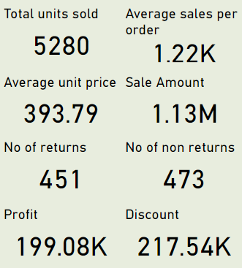
Sales performance metrics
They represent crucial metrics for evaluating sales performance, such as 1. Total Units Sold
2. Average Sales per Order
3. Sales Percentage
4. Sale Amount
5. Profit
6. Discount
7. Return Count
8. Non-Return Count

Slide 12
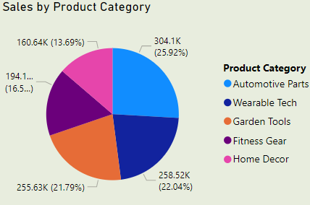
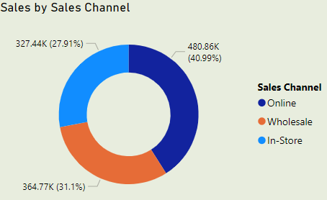
Key Insights for Sales Performance
By Product Category:
Automative Parts contribute 25.92% (304.1K), ranking second.
Wearable Tech lead sales with 22.04% (258.52K).
By Sales Channel:
Online Channel dominates with 40.99% (480.86K).
Conclusion: Automotive parts, Wearable Tech and online channels are the key drivers of sales.

Slide 13
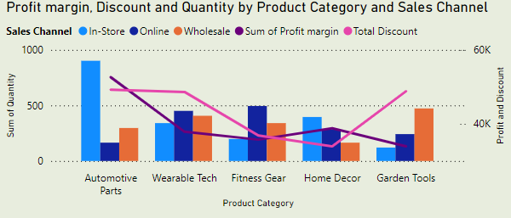
Product performance
Top Performer: Automotive Parts with the highest quantity sold, driven by In-Store sales.
Profit Margin: Peaks in Automotive Parts because of discount is less, declines in Wearable Tech due to high in discount, but recovers in Home Decor.
Sales Channel Highlights:
In-Store dominates Automotive Parts.
Online excels in Wearable Tech, Fitness Gear.
Wholesale leads in and Garden Tools.

Slide 14
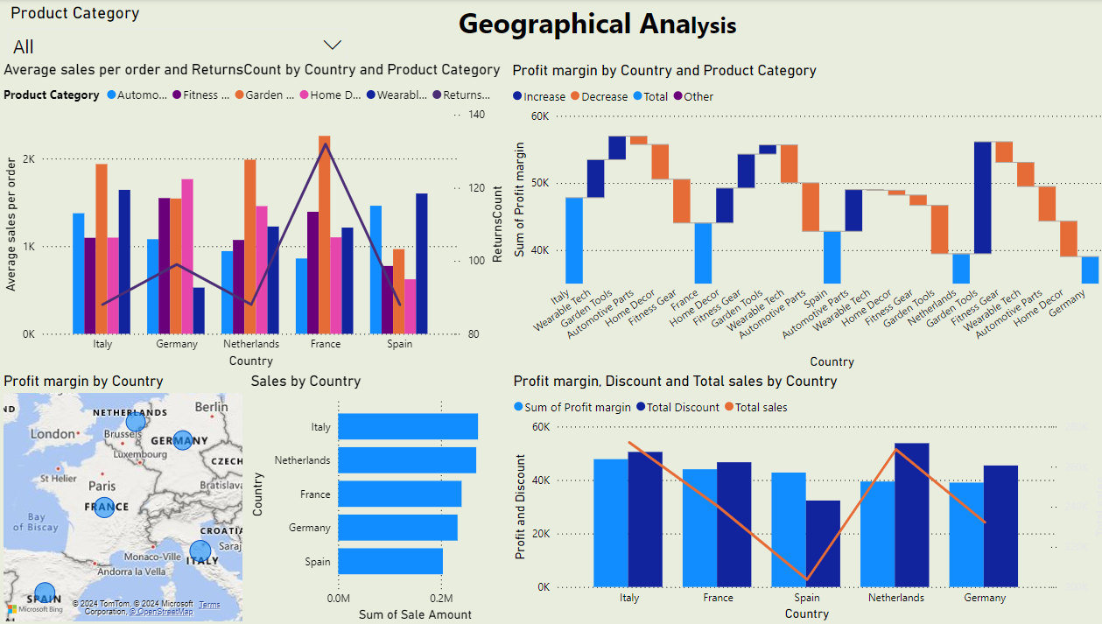
Geographical Analysis

Slide 15
Geographical Analysis
Sales performance:
Top-performing countries in profit: Italy and France
Top-performing countries in sales: Italy and Netherlands
Italy and Germany: Highest average sales per order with moderate returns.
France: Low average sales but significantly high Returns Count.
Germany: Negative margin in several categories, requiring corrective measures.
Recommendations:
Italy is the most profitable and balanced market
Germany needs margin improvement, focusing on underperforming categories.
Reduce returns in France to boost efficiency and profitability.

Slide 16
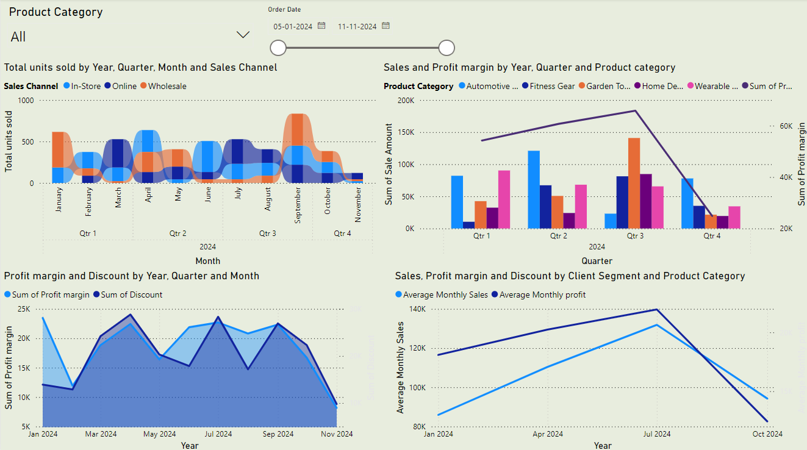
Trend Analysis

Slide 17
Trend Analysis
Key Insights:
Monthly and Quarterly Trends:
Quarter 3 peaked in sales nearly 190K and profit nearly 70K but showed a decline in Quarter 4.
Sales Channels:
In-store dominated throughout the year, wholesale dominates in August and September with over 900 units sold.
Profit vs. Discounts:
Higher discounts negatively impacted profit.
A balance between the two is critical for profitability.
4. Performance by Month:
Significant sales spikes in September (peak sales units)
and profit drops by November.
Recommendations:
Optimize Q4 Strategies: Focus on underperforming categories like Garden Tools, Home Decor.
Channel Diversification: Maintain and optimize the performance of online and wholesale channels while exploring new strategies to further enhance in-store sales.
Profit-Discount Balance: Reduce excessive discounts to sustain profit margins.
Leverage Peaks: Reinforce efforts in Q3 months to capitalize on high sales and profit.

Slide 18
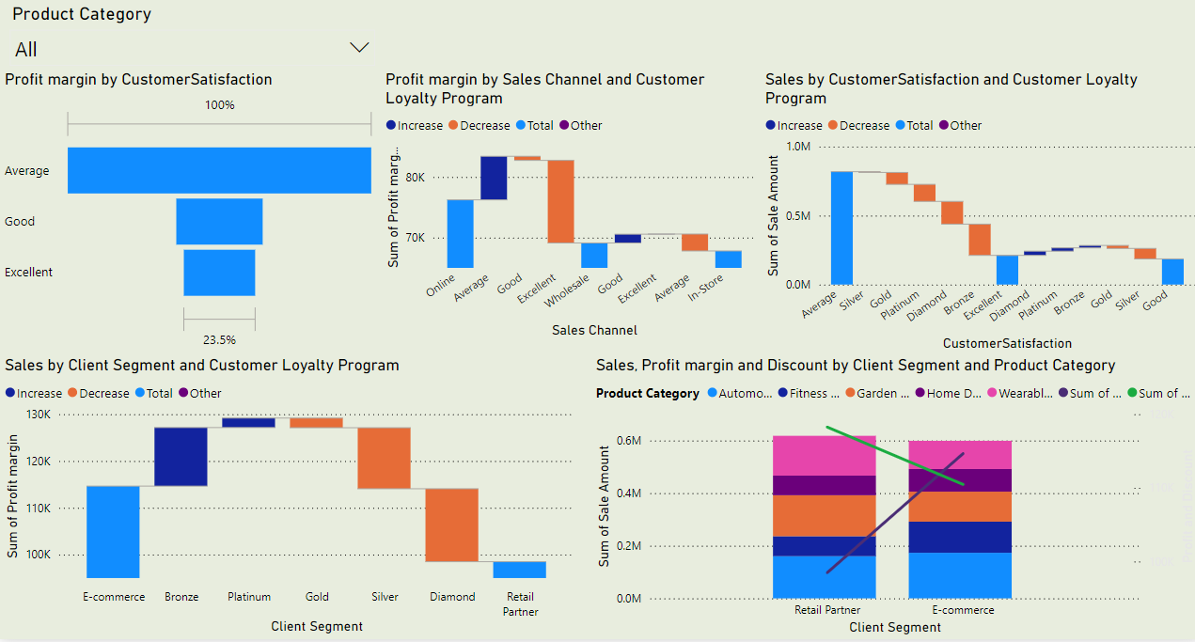
Customer segmentation Analysis

Slide 19
Customer segmentation Analysis
Customer Satisfaction Analysis:
"Average" satisfaction level contributes the most to profit margin (140K).
Sales Channel Insights:
Online channels outperform Instore and Wholesale channels in profit margins.
Product Category Trends:
Automotive and Fitness categories lead in sales across Client Segments.
Discounts are higher for Retail Partners, affecting profit margins.
Recommendations:
Focus on enhancing profit strategies in Retail Partner.
Improve satisfaction levels among Excellent and Good categories.
Diversify PayPal adoption strategies to boost performance.

Slide 20

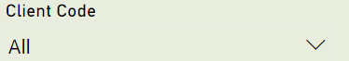
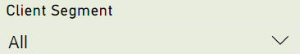
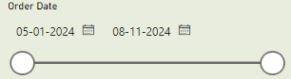
Customer segmentation Analysis
Filter Options: Allows filtering by Client Code and Client Segment.
Date Range: Slider for selecting a specific analysis period.
Interactive Analysis: Enables customized data views based on selections.

Slide 21
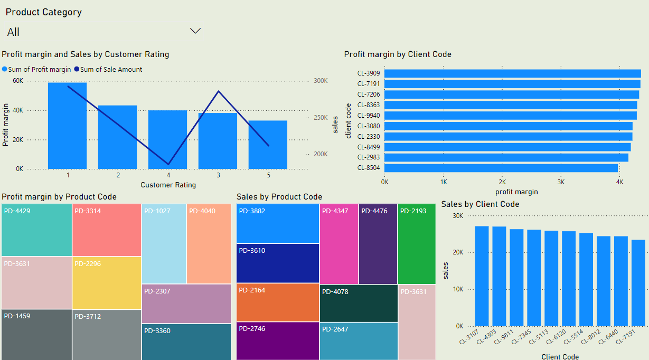
Top Performance Analysis

Slide 22
Top Performance Analysis
Profit Margin vs. Customer Rating: The highest profit margin is observed for customers with a rating of 1, 3 and 2, while ratings 4 and 5 contribute less to profitability.
Top Performing Products: Products like PD-4429 and PD-3314 generate the highest profit margins, while PD-3882 and PD-3610 lead in sales volume.
Profit Margin by Client: Clients CL-3909 and CL-7191 contribute the most to profit margins, showing strong business value.
Sales by Client: Sales are evenly distributed among top clients, with CL-3107 leading slightly.
Recommendations: Focus on retaining high-rated customers and promoting high-performing products for profit and sales optimization.

Slide 23
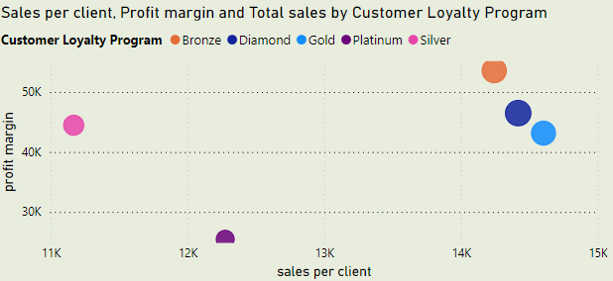
Customer Profitability Analysis
Bronze Loyalty Program: Achieves the highest profit margin, indicating highly profitable customer engagements despite relatively fewer sales per client.
Diamond and Gold Programs: Show a balance with higher sales per client and profit margins, highlighting strong customer spending and profitability.
Recommendations:
Focus on sustaining the performance of Bronze, Diamond, and Gold while redesigning strategies to boost engagement and profitability in Platinum and Silver.

Slide 24
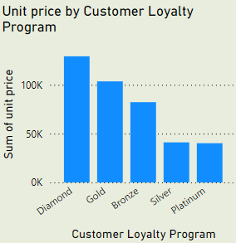
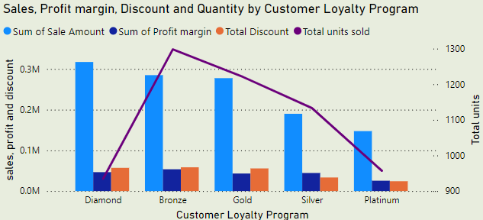
Customer loyalty program analysis
Unit Price Analysis:
Diamond and Gold tiers lead with the highest unit prices (over 100K).
Sales and Metrics Overview:
Diamond Tier: Highest Sales Amount (0.3M) but lowest Profit Margin due to discount.
Bronze Tier: Best Profit Margin increases compared to diamond but still discount is high.
Quantity:
Bronze Tier: Highest quantity sold nearly 1300 but unit price is less in bronze. so, sales is decrease when compared to diamond.

Slide 25
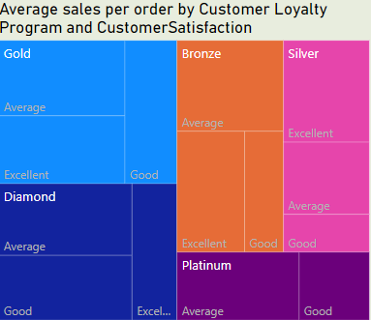
Average Sales Per Order by Customer Loyalty Program
Best Performing Programs:
Gold and Diamond: Highest average sales per order with highest average customer satisfaction. Mixed satisfaction but good sales performance.
Bronze: Moderate sales with varied satisfaction levels.
Underperforming Programs:
Platinum: Average satisfaction and weak sales performance.
Insight: Focus on boosting Platinum and silver sales strategies and leveraging the high satisfaction in Gold and diamond programs to drive more sales.

Slide 26
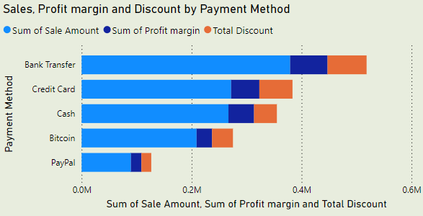
Payment Method Analysis
Bank Transfer: Highest Sales Amount (~0.6M) and Discounts, but moderate Profit Margin.
Credit Card: Balanced Sales (~0.4M) and Profit Margin, with notable discounts.
Cash: Moderate Sales with a good Profit Margin.
Insight: Bank transfers drive revenue but rely heavily on discounts, while cash ensures profitability with fewer discounts.
Recommendation : Diversify PayPal adoption strategies to boost performance.

Slide 27
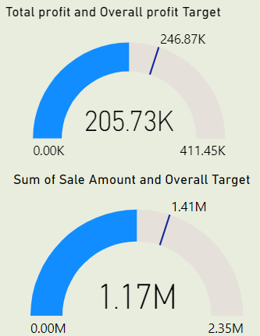
Target Sales Analysis
Sales Performance: Achieved sales amount is 1.17M against a target of 1.41M.
Profit Performance: Generated profit is 205.73K with a target of 246.87KK.
Progress Tracking: Both sales and profit are progressing but are currently below the set targets.

Slide 28
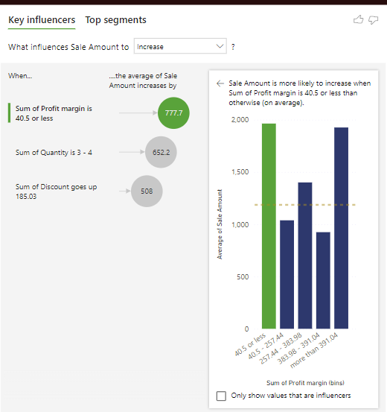
Key Influencer
Sales amount is influenced by:
Profit Margin: Increases in sales are more likely when the profit margin is 40.5 or less.
Quantity: Sales amount tends to increase when the quantity is between 3 to 4 units
Discount: Higher sales are associated with discounts above 185.03.

Slide 29
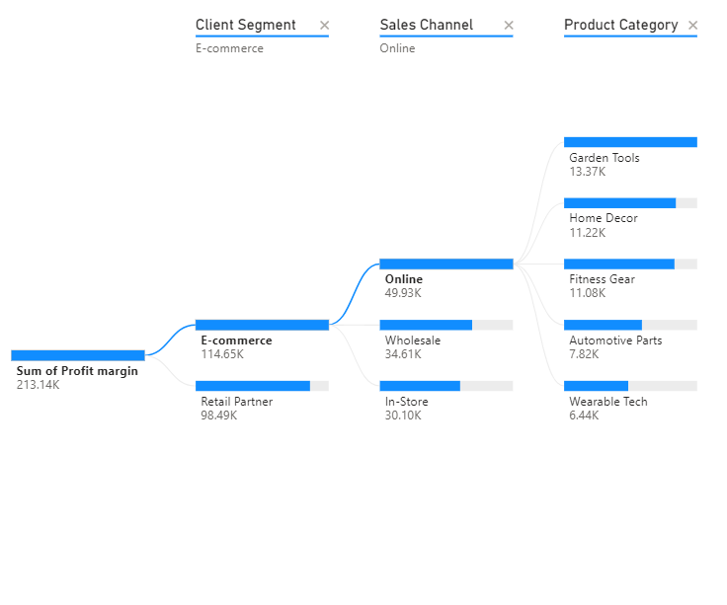
Profit Margin Breakdown
E-commerce contributes the highest profit margin, followed by Retail Partner.
Online sales channel has the highest profit within E-commerce, while Wholesale and In-Store follow.

Slide 30
Proposal with Innovative Outcomes
By employing a comprehensive BI approach to sales data, this project brings several innovative outcomes:
Enhanced Decision-Making: Granular insights into sales performance by category, region, and sales channel allow decision-makers to target high-value customers and optimize underperforming areas.
Customer Satisfaction Segmentation: Analyzing customer ratings provides actionable insights into customer satisfaction, guiding personalized service strategies.
Profit Optimization: Measures such as Gross Profit Margin, Total Discount, and Actual Cost allow the business to assess and enhance profitability.
Customer Retention and Loyalty: Leveraging metrics on customer loyalty programs and marketing campaigns provides insights into customer retention strategies, driving repeat business.

Slide 31
Future Enhancements
Advanced Analytical Capabilities:
Dynamic Sales Target Adjustment: Implement AI-driven dynamic targets that adjust based on seasonality, economic factors, and competitor pricing.
Cross-Sell and Upsell Opportunities: Use association rule mining (e.g., Apriori algorithm) to identify product combinations frequently purchased together and recommend upsell opportunities.
Customer-Centric Strategies
Real-Time Customer Experience Monitoring: Monitor customer feedback and social media mentions to understand their mood in real-time.
Journey Analysis: Study how customers interact across channels to improve their experience.

Slide 32
Profitability Enhancements
Profit Maps: Visualize regional profits by product and channel to focus on high-earning areas.
Discount Elasticity Analysis: Test and learn how discounts impact sales and profits for smarter pricing.
Operational and Reporting Improvements
Automated Anomaly Detection: Use AI to spot unusual sales trends immediately.
Mobile-Friendly Dashboards: Create easy-to-use, mobile-friendly dashboards for quick updates on the go.
Strategic Expansion and Innovation
Market Predictions: Simulate potential success in new global markets using past data.
Unified Sales Tracking: Combine data from stores, online, and wholesale to get a complete view of performance.

Slide 33
Conclusion
The Sales Performance Analysis project showcases the power of Business Intelligence in enabling data-driven decision-making. By implementing targeted DAX measures and exploring insightful metrics, this project lays the foundation for ongoing improvements in sales strategies, customer experience, and profit margins.
Future analyses focusing on predictive modelling and customer retention will further amplify the business’s responsiveness and agility in a dynamic market environment.

Slide 34
Thank You

